Slide 1
First Aid & CPR
Recognizing & Responding to Emergencies
Emergency Action Steps
Moving Victims

Slide 2
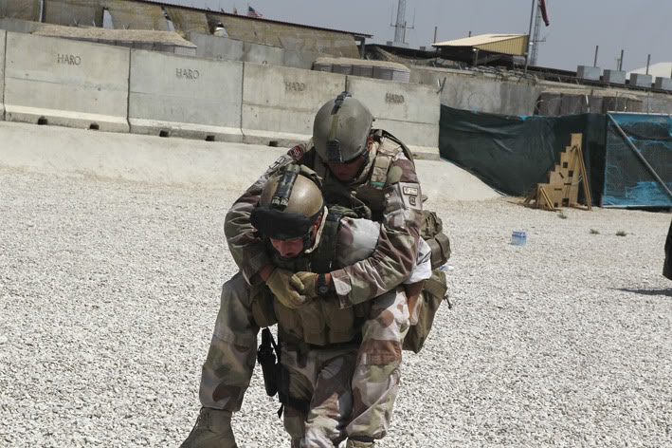
First Aid & CPR
Rescue Moves

Slide 3
First Aid & CPR
Introduction
Thumbs Up = True / Thumbs down = False
It is generally not a good choice to move an injured person
However, there are 3 instances when you would have to move a injured person
In your groups, list 3 instances when you would have to move an injured person

Slide 4
First Aid & CPR
Rescue Moves
Objectives
Students will be able to:
Identify when it is safe to move Victims
Understand how to move Victims
Practice moving Victims

Slide 5
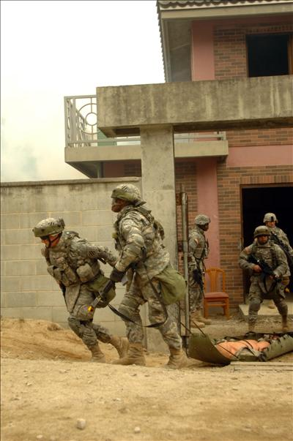
First Aid & CPR
Rescue Moves
When do you perform a Rescue Move?
Immediate Danger/Unsafe

Slide 6
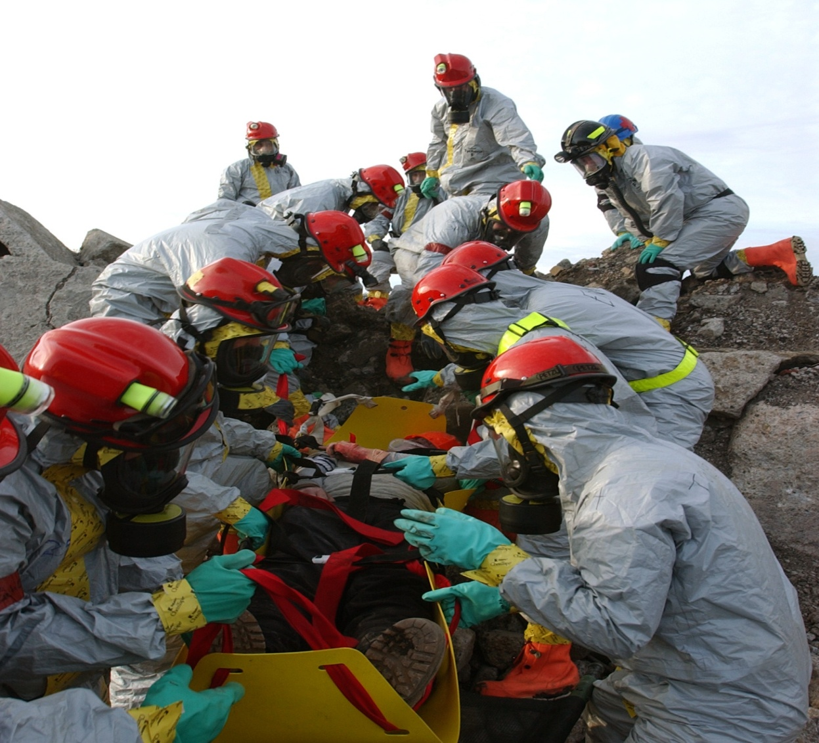
First Aid & CPR
Rescue Moves
When you need to
Access other victims who may have more serious injuries

Slide 7
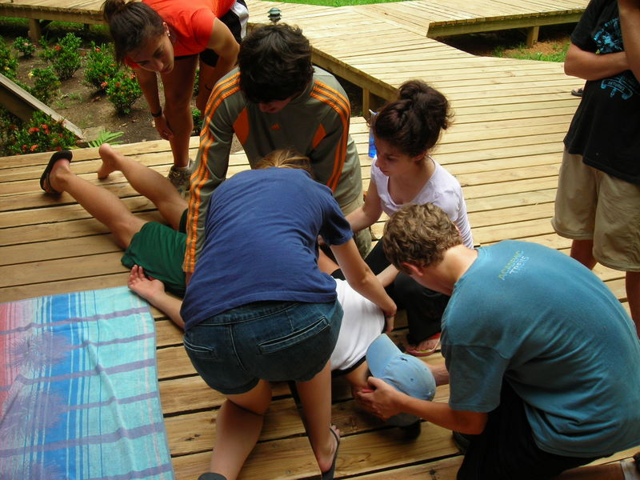
First Aid & CPR
Rescue Moves
When you need to
Provide proper care

Slide 8
First Aid & CPR
Rescue Moves
Depends on
  Your safety & victims safety
  Your size and strength
  Victim’s size and weight
  Type of Injury
  Situation
  If you have help

Slide 9
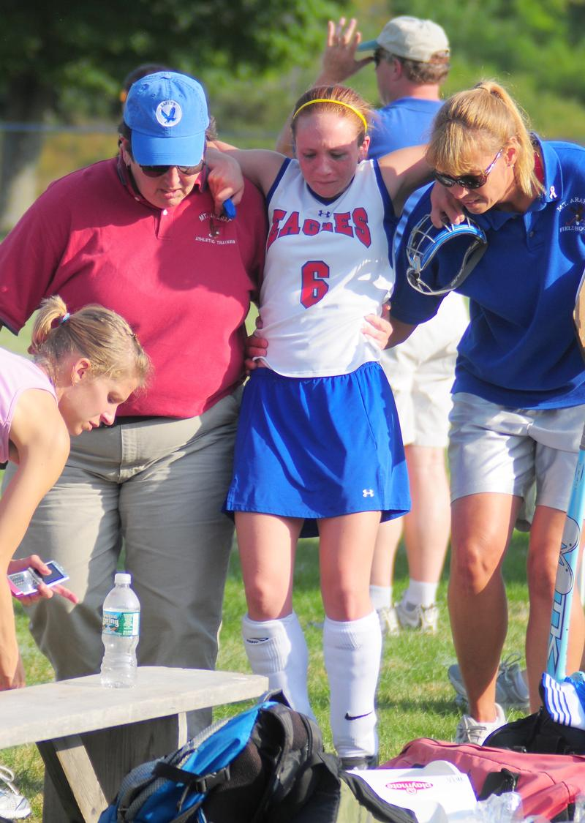
First Aid & CPR
Rescue Moves
2 basic things you must do during a move
Support the Victim
Move the Victim

Slide 10
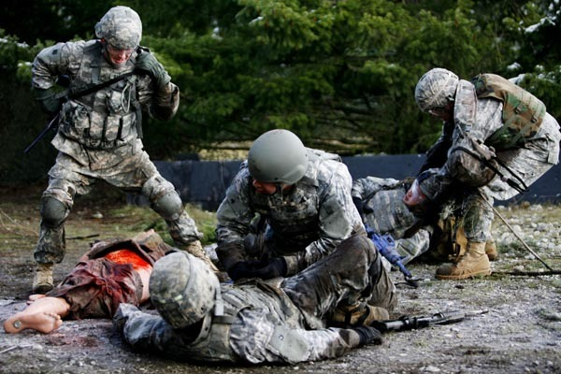
First Aid & CPR
Rescue Moves
3 types of moves
Assists
Carries
Drags

Slide 11
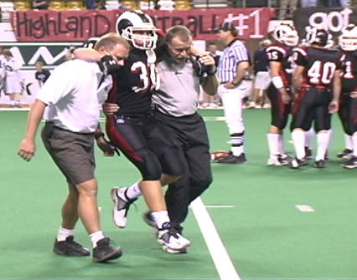
First Aid & CPR
Rescue Moves
Assists
Walking Assist
  Most basic
1 Person
2 Person
Your shoulder fits into victims arm pit
Other hand around waist
Conscious & no head, neck, back injuries

Slide 12
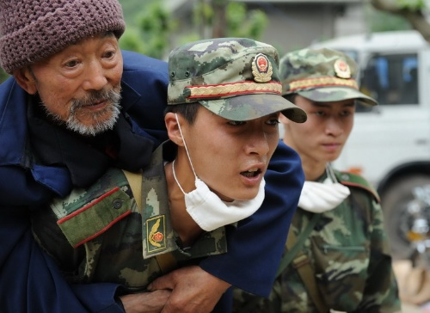
First Aid & CPR
Rescue Moves
Carries
Pack Strap
Support from
standing position
Your shoulders fit into victim’s arm pits
Cross victims arm in front & grasp wrists
Lean forward

Slide 13
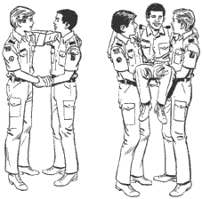
First Aid & CPR
Rescue Moves
Carries
2 person seat carry
Interlock arms
Victims arms around your necks
Arms across victims back
Arms placed behind knees

Slide 14
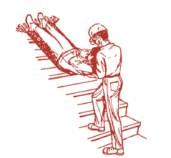
Aid & CPR
Rescue Moves
Drags
Clothes Drag
Blanket Drag
Only technique that supports head, neck & back
Position Victim on back
Grasp behind neck

Slide 15
First Aid & CPR
Rescue Moves
Remember:
Only move Victim ONLY if there is immediate danger
First: Support the Victim
Second: Move the Victim
Always lift with your legs - NOT your back

Slide 16
First Aid & CPR
Rescue Moves
Get into groups your groups
Practice:
  Assists – 1 and 2 person
  Carries – Pack Strap and 2 person seat carry
  Drags – Clothes/Blanket Drag

